Slide 1
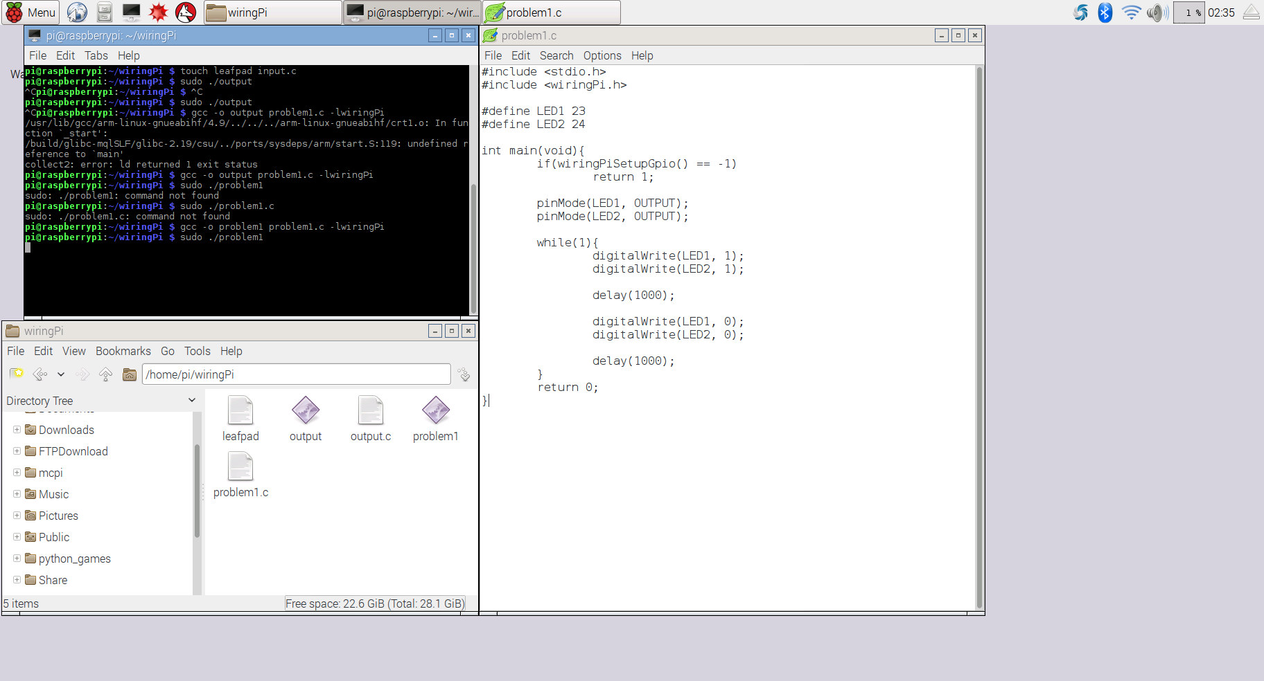
1. Implement the circuit with source code on page 131 . (C language)

Slide 2
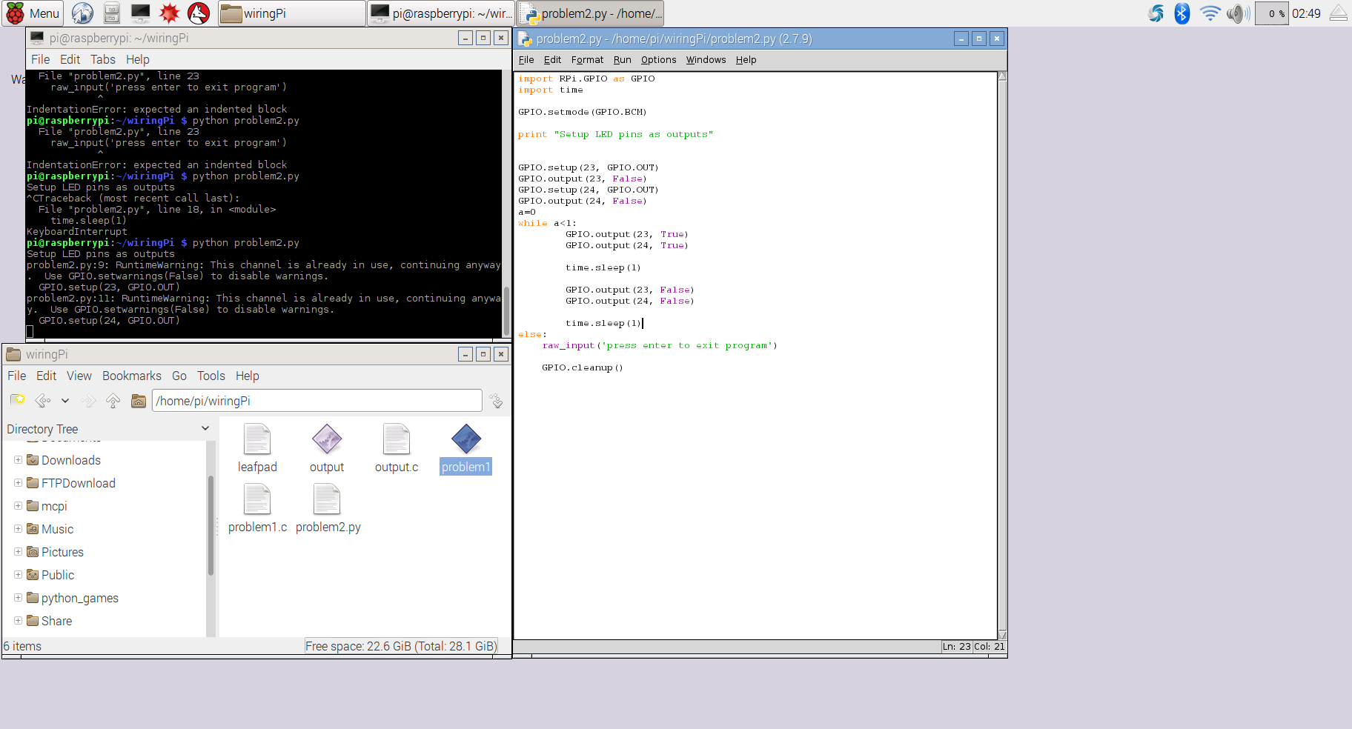
2. Implement the circuit with source code on page 131 (Python language)

Slide 3
